Slide 1
Courant Math 2799.001
Modeling & Risk Mgt of Bonds & Securitized Products
Lecture 4: Prepayment Drivers, Toy Monte Carlo OAS model
April 15, 2024
Prof: Rodney Sunada-Wong rsw8@nyu.edu
TA: Edison Lee el2700@nyu.edu

Slide 2
Topics
Homework from Previous Lecture
Prepayment Drivers:
Turnover
Re-Fi incentive
Default
Conceptual OAS model
Homework

Slide 3
Homework from previous lecture
Read Ch. 15 of Salomon Smith Barney Guide to Mortgage-Backed and Asset-Backed Securities by Lakhbir Hayre
For a $100MM pool of 6.50% WAC 30yr loans with 70bps servicing/g-fee
Create a Sequential structure with 4 tranches :
A: $45MM, B: $25MM, C: $20MM, D: $10MM
For ten PSA scenarios (from 50 PSA to 500 PSA in increments of 50), calculate and graph WAL for each tranche (x-axis: PSA speed, y-axis: WAL).
List the tranches in declining order of sensitivity (of WAL as a function of PSA) and explain why these tranches are in this order
For the same pool
Instead create a PAC structure with one PAC (with 100 and 250 PSA bands), and one Companion, assuming they pay the same coupon. (To calculate the initial notional of the PAC, sum up the smaller of each month’s principal cash flows under 100 PSA and under 250 PSA. The Companion’ notional will be [$100MM – the PAC notional].)
For the ten PSA scenarios, generate graphs of principal cash flows for the PAC and for the Companion, and explain why the PAC busts or does not bust for the different scenarios.
Remember: The sum of the parts must equal the whole!

Slide 4
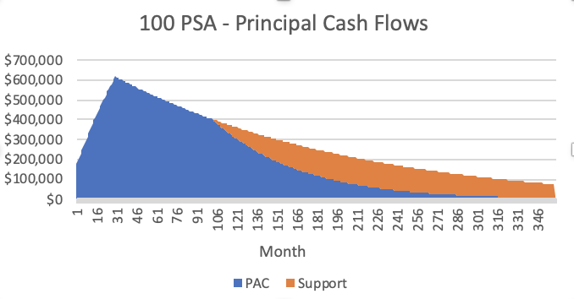
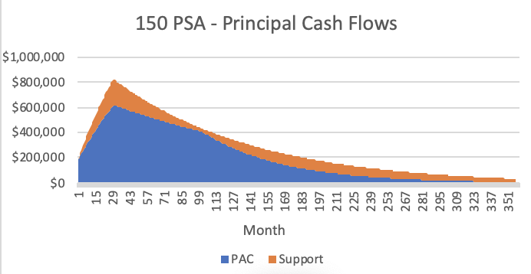
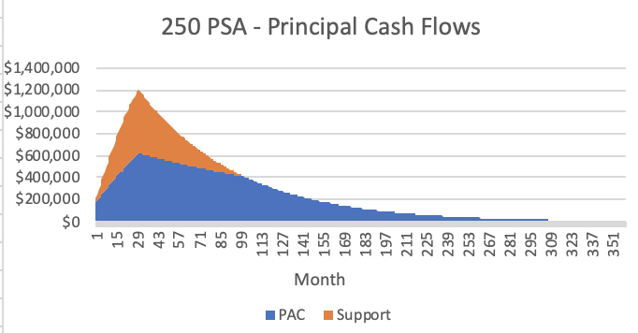
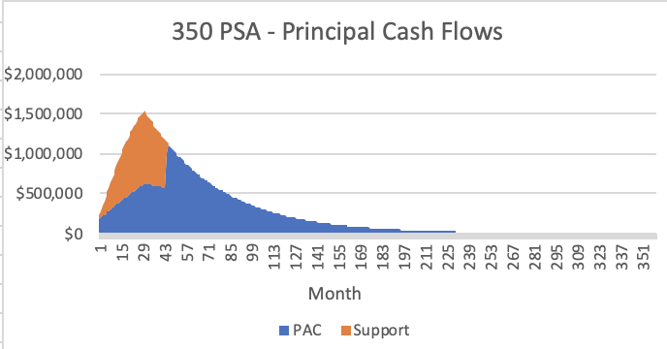
Homework from previous lecture

Slide 5
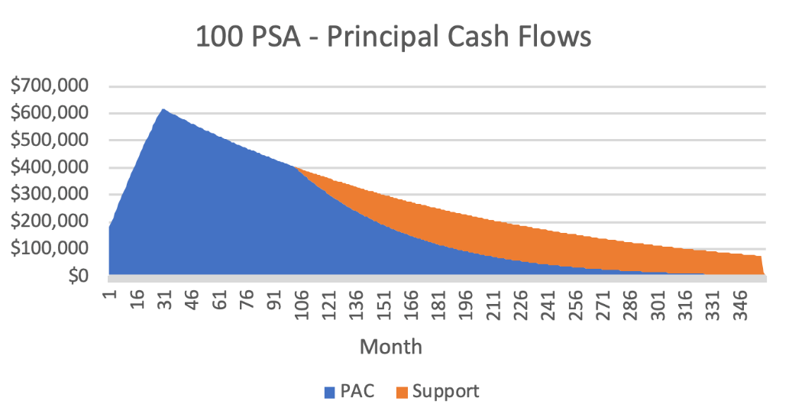
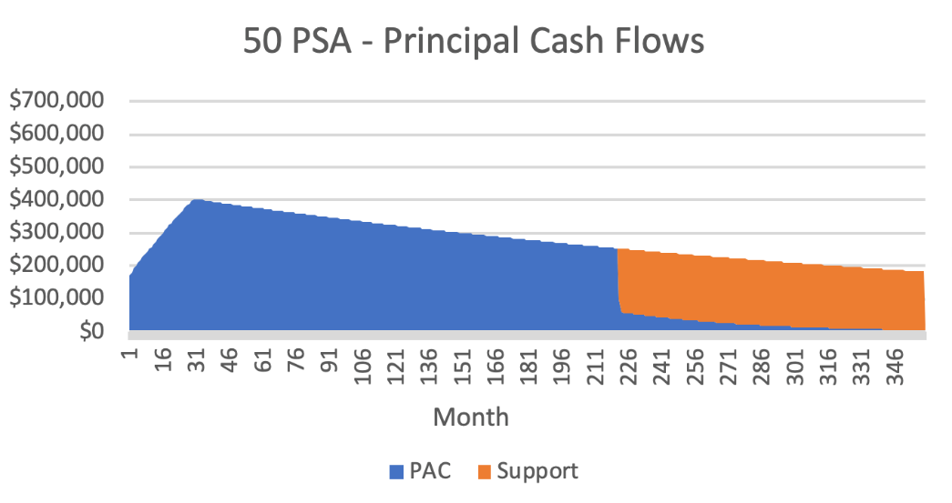
Homework from previous lecture: If lower band breaks
Cumulative principal payments to PAC are slower than scheduled
Proritize principal payments to PAC until the PAC is back on schedule
Once cumulative principal paid to PAC catches up to the originally scheduled principal, then the allocation of principal returns to to normal
(Note: both the PAC and the Support bond “extend”.)

Slide 6
Prepayment Drivers: 1) Refinancing
Certain factors impact prepayment behavior
Refi-incentive, a function of:
A borrower’s existing mortgage rate vs rates currently available from banks
Loan Size
“Closing” costs
Shape of the Yield Curve
The speed of refinancings is reduced by “Burnout”
Factors affecting borrower’s ability to refinance
Current LTV(Loan to Value)
Credit worthiness / FICO
Investor vs Owner-Occupied
Source: L. Gauttier

Slide 7
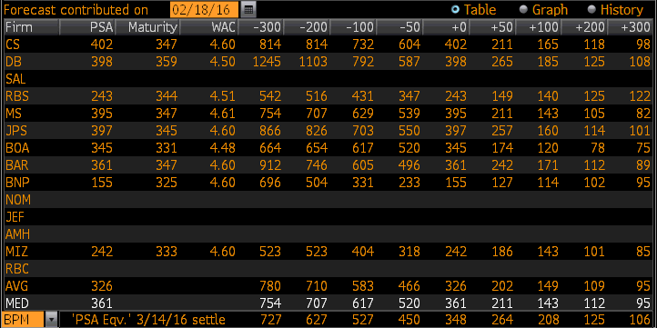
Refi-Incentive
“S-Curve”: a graphical way of measuring the refi-incentive
In the “S-Curve”, the CPR, SMM, PSA are functions of the difference between a borrower’s mortgage rate and the prevailing mortgage rate available
Notice the range of estimates
Prepayment is behavioral =>
Models are estimates
Models are not perfect
Source: Bloomberg “FGLMC 4 Mtg VALL”

Slide 8
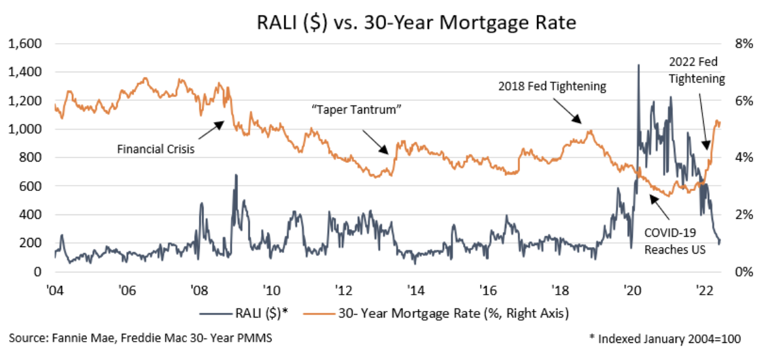
Refinance Applications vs 30yr Mortgage Rates
Generally, as Mortgage Rates drop, homeowners submit more Refinance Applications
And as Mortgage Rates rise, refinance applications drop
https://www.fanniemae.com/research-and-insights/perspectives/introducing-fannie-mae-refinance-application-level-index

Slide 9
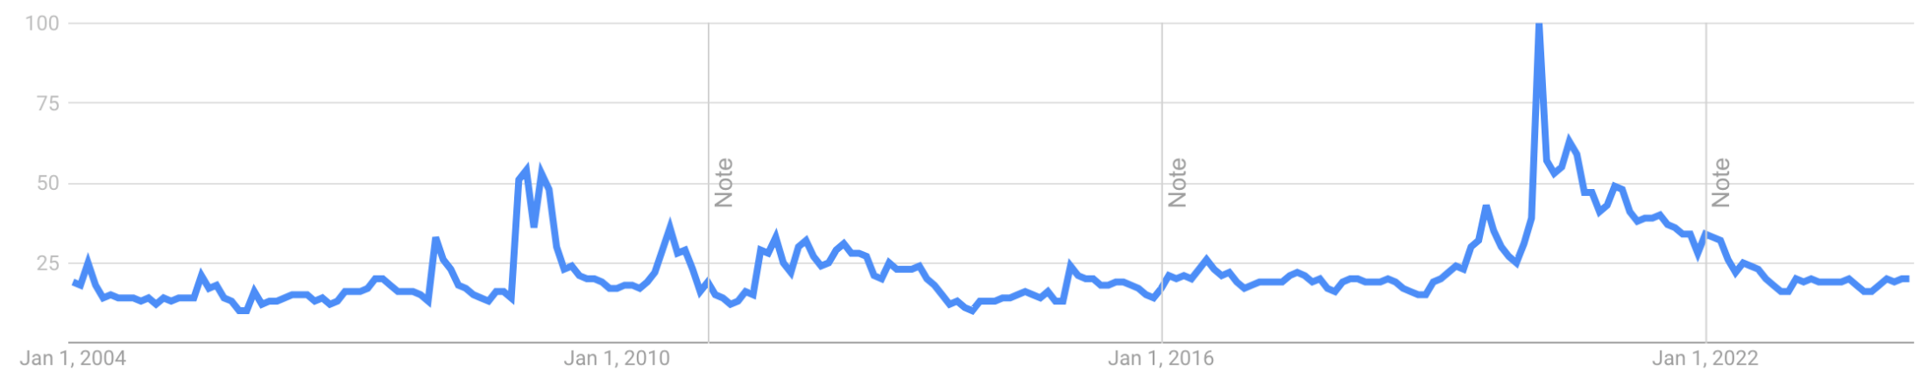
Publicity / Media Effect
What is this graph?
Google: Search Trend for “Refinance”
COVID 19
Financial Crisis
https://trends.google.com/trends/?geo=US

Slide 10
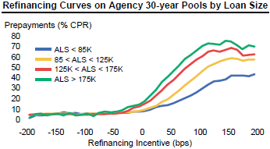
Refi-Incentive
Loan size vs. closing costs
Borrowers with larger loans have larger refinancial incentives than borrowers with smaller loans
Why are speeds for
Green >. Red > Orange > Blue?
Source: L. Gauttier

Slide 11
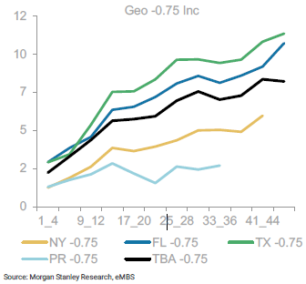
Refi-Incentive
Closing Costs (larger closing costs slow down prepayment speeds)
fees associated with replacing a mortgage with a new mortgage
“Title insurance” – insurance that there are no “liens” on the property
Appraisal fee
Attorney fees
Survey Fee
Mortgage application fee
https://en.wikipedia.org/wiki/Closing_costs
Closing costs vary by state
E.g. New York has a “mortgage recording tax”
1% to 1.5% of the mortgage!
https://www.tax.ny.gov/pit/mortgage/mtgidx.htm
This makes it expensive in NY to refinance
CPR’s by state
“Inc” is the magnitude of the refi incentive expressed in percents or 0.75% or 75bps

Slide 12
Refi-Incentive
Shape of the Yield Curve:
Borrowers can switch between products
30yr, 15yr, Hybrid ARMs, ARMs
Product Transitions vs. 15-30 Mortgage Rates (%)
Colored lines (LHS):
The speed that borrowers switch from
30yr mortgage to 15yr mortgage
30yr mortgage to 10yr mortgage
Blue-green columns (RHS):
The difference between the
30yr mortgage rate
15yr mortgage rate
Why did the speeds behave this way?

Slide 13
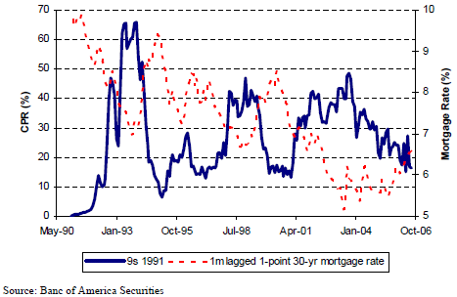
Burnout
Burnout: Through time, prepayments speeds are less responsive to drops in interest rates!
Why is that?
those who remain in the pool are less likely to prepay

Slide 14
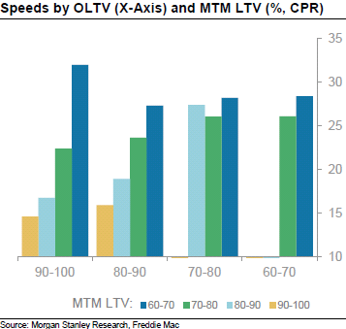
Factors affecting a borrower’s ability to refinance
1) Current LTV
(as opposed to original LTV)
Why this slope?
Why this slope?
Ability to refinance

Slide 15
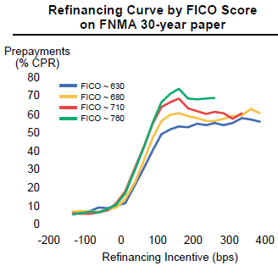
Factors affecting a borrower’s ability to refinance
2) Credit Worthiness
Why are speeds for
Green >. Red > Orange > Blue?

Slide 16
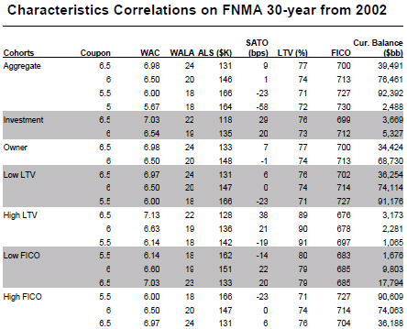
Some phenomenon that can be observed about loan metrics:
Notice high correlations among
loan size
Spread At Origination (SATO)
LTV
FICO

Slide 17
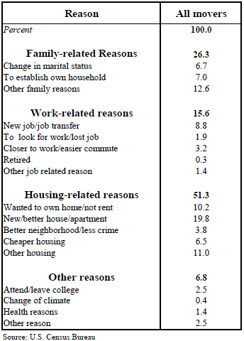
Prepayment Drivers: 2) Turnover
Turnover: Sales of homes
What impacts Turnover?
Breakout Rooms

Slide 18
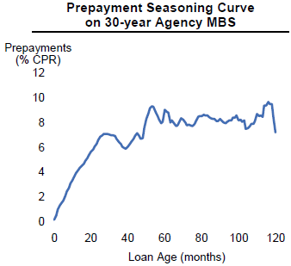
Turnover
Tends to stabilize in the 6-10% CPR range
Seasoning
Seasonality
Source: S. Chaudhury
Source: L. Gauttier
Notice the shape of this curve (just includes “turnover”)
Look familiar?

Slide 19
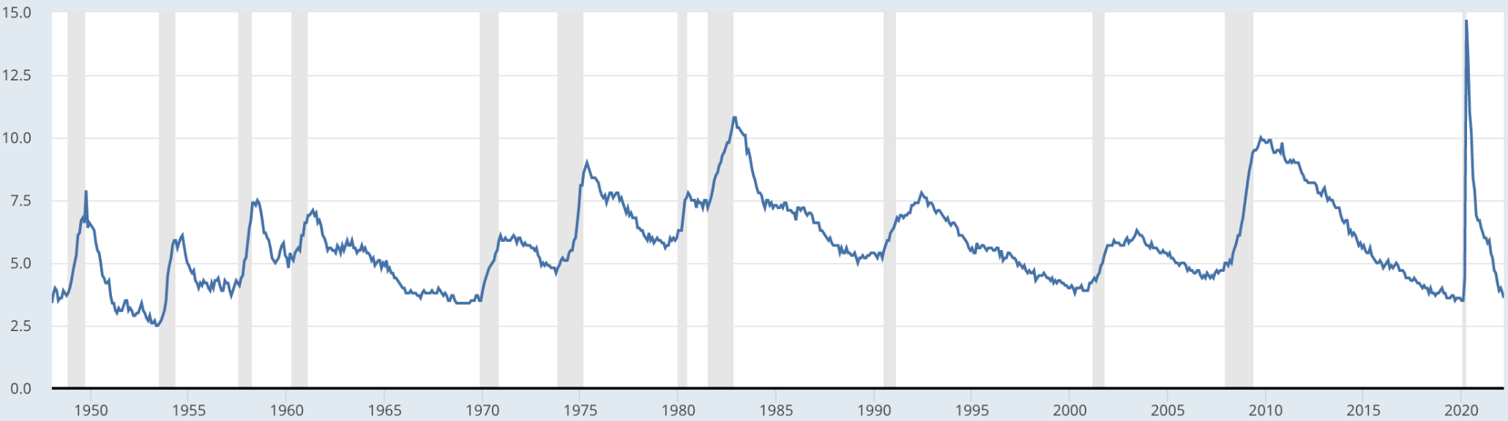
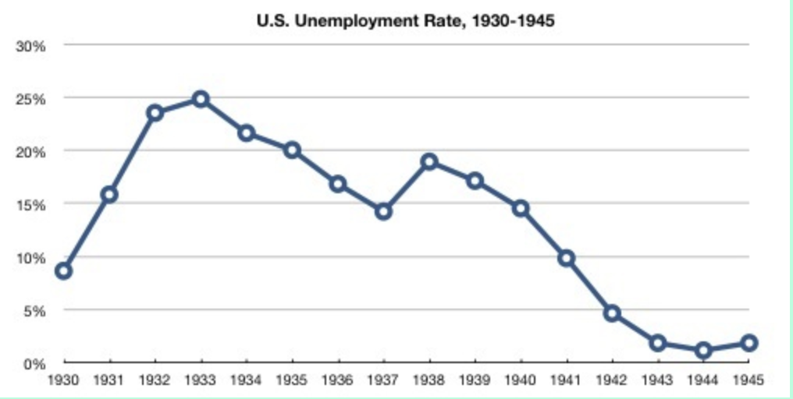
Factors Impacting Turnover
Work-related
Civilian Unemployment Rate
U-3: Number of unemployed as a % of labor force (16+yrs, not in institutions (e.g., penal and mental facilities, homes for the aged), not on active duty in Armed Forces.
https://fred.stlouisfed.org/series/UNRATE
https://www.sjsu.edu/faculty/watkins/dep1929.htm

Slide 20
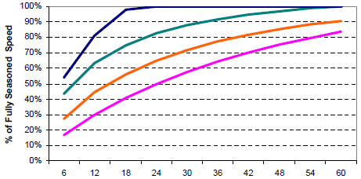
Factors Impacting Turnover
Home Price Appreciation Seasoning
Source: Banc of America Securities
What would you have expected would happen to home price appreciation
during the pandemic?
=> Would you have expected prepayment to speed up or slow down?

Slide 21
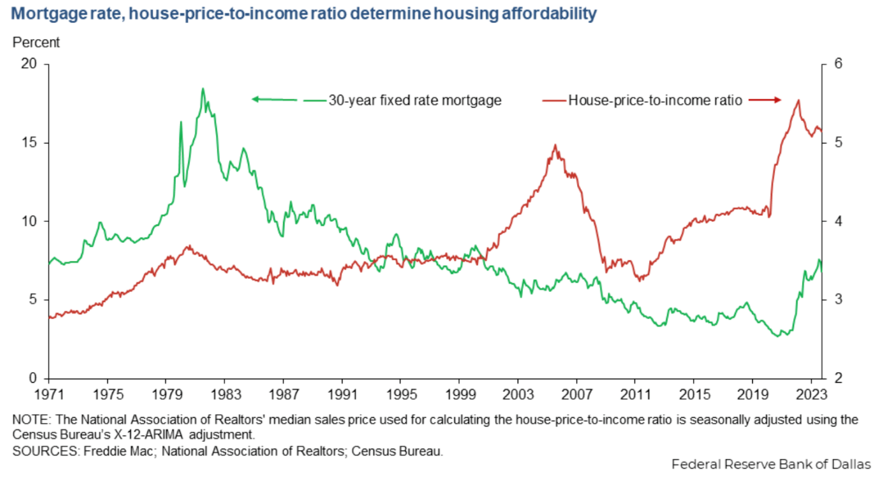
Factors Affecting Turnover
But
combining increases in the “real” price of homes
with the impact of higher interest rates,
Housing is less affordable now than it has been for several years
http://www.econ.yale.edu/~shiller/data.htm. “Fig 3-1”. https://www.dallasfed.org/research/economics/2024/0402

Slide 22
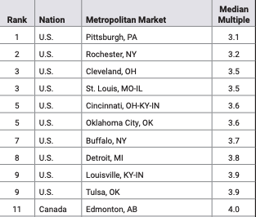
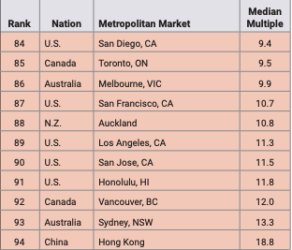
Factors Impacting Turnover
Housing Affordability *
2022 most affordable metropolitan areas **
Least affordable metropolitan areas
* The median house price divided by the gross median household income (pre-tax).
** In 94 major metropolitan areas across 8 nations: Australia, Canada, China, Ireland, New Zealand, Singapore, the United Kingdom, the United States
Source: http://www.demographia.com/dhi.pdf

Slide 23
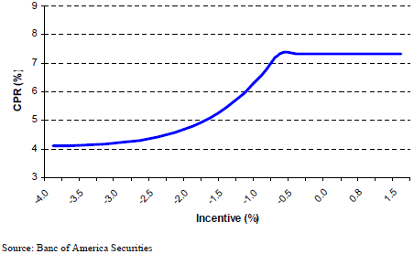
Factors Impacting Turnover
* A negative Refi-incentive causes the “Lock-in effect”
* A positive Refi-incentive usually has minor impact on turnover
The "lock-in effect" refers to a situation where borrowers are discouraged or "locked in" from refinancing their mortgages due to the negative incentive. Because it would cost more to refinance than to keep the existing mortgage, borrowers are effectively "locked in" to their current mortgage, unable to take advantage of potentially lower interest rates or better loan terms in the market.

Slide 24
The rapid rise in interest rates in 2022…
`
Source: https://www.treasury.gov/resource-center/data-chart-center/interest-rates/Pages/TextView.aspx?data=yield
Spreadsheet “US Treasury Yield History and Recessions YYYYMM.xls in Columbia directory”

Slide 25
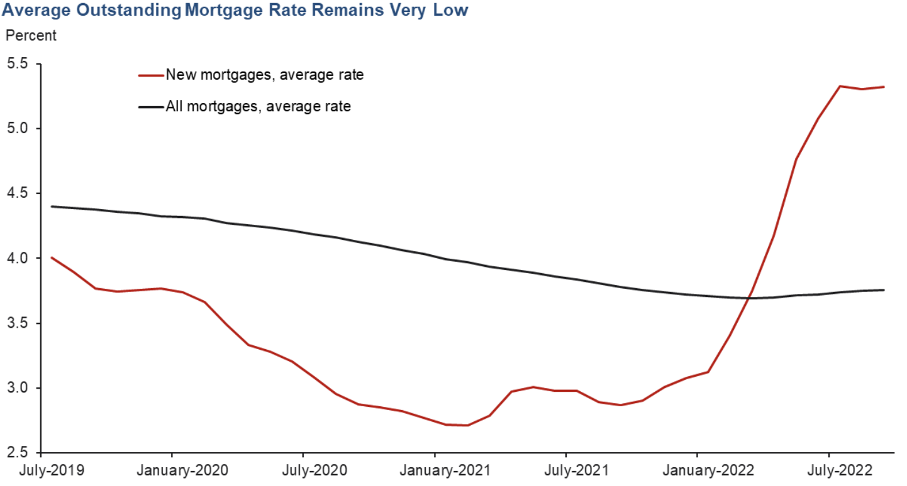
Impacts the ability to sell a house and buy a new one
For many years, homeowners have been able to refinance their mortgages at lower rates
By 2021, many home owners had locked in low mortgage rates
Now that rates are higher, selling a home (that has a mortgage), and buying a new home (with a mortgage) => higher mthly pymts and a negative refi incentive
https://www.dallasfed.org/research/economics/2022/1227
https://www.freddiemac.com/research/forecast/20230817-economic-housing-and-mortgage-market-outlook-august-2023

Slide 26
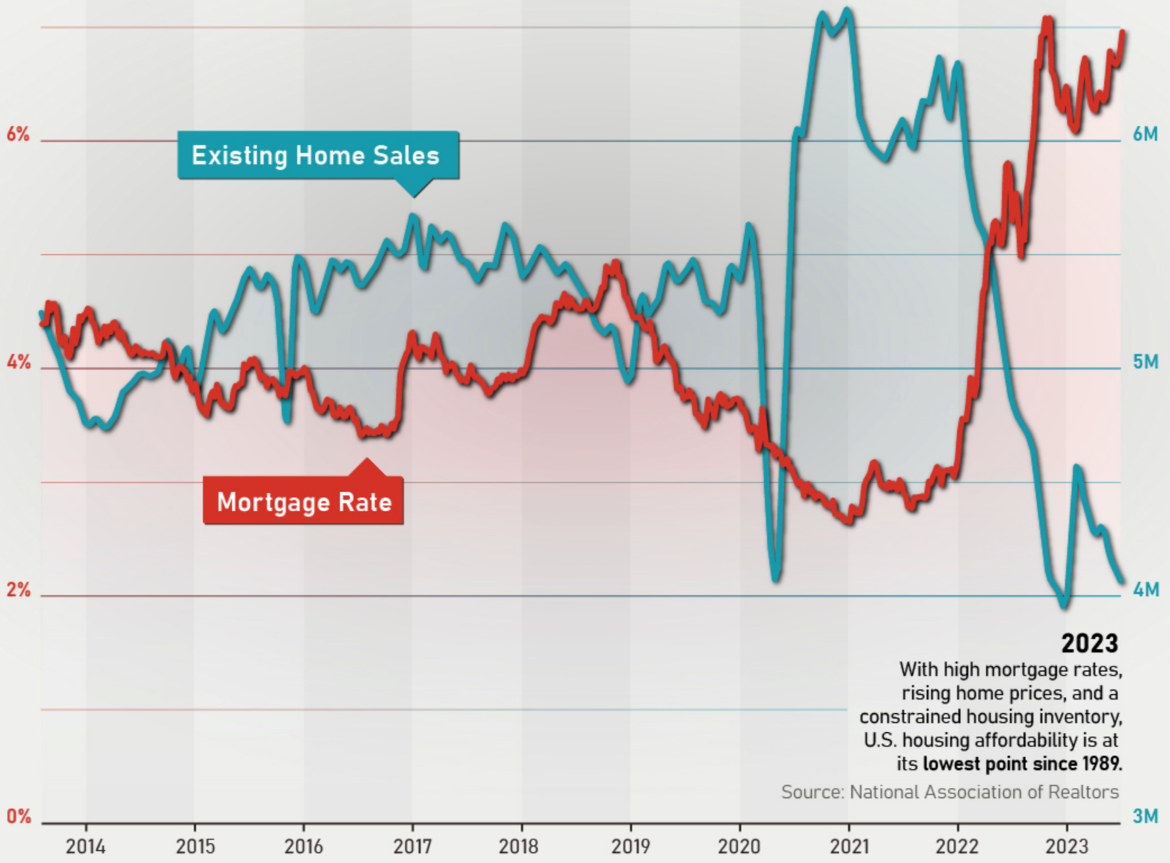
The lock-in effect 2023
Sales of homes are down very considerably from prior years
https://talkmarkets.com/content/real-estate--reits/charted-the-us-mortgage-rate-vs-existing-home-sales?post=414306

Slide 27
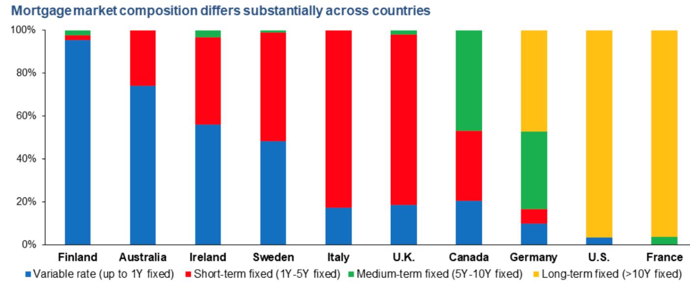
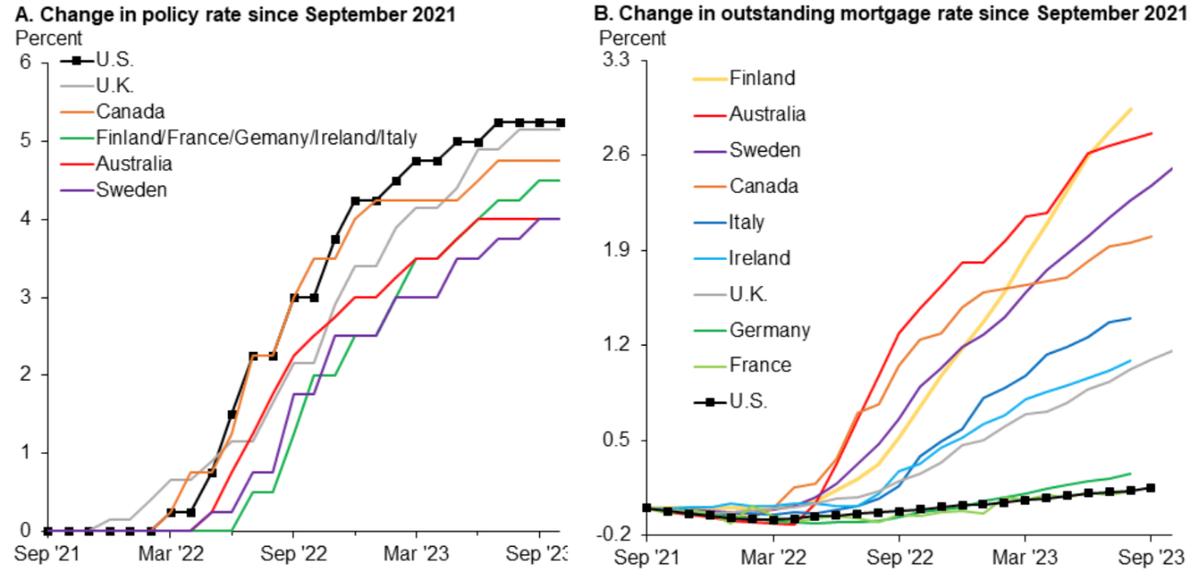
The U.S. mortgage market is different from many other countries
Many other countries’ mortgages are fixed-rate for much shorter periods of time:
So existing homeowners mortgage costs have risen much more quickly than in the U.S.
https://www.dallasfed.org/research/economics/2024/0116

Slide 28
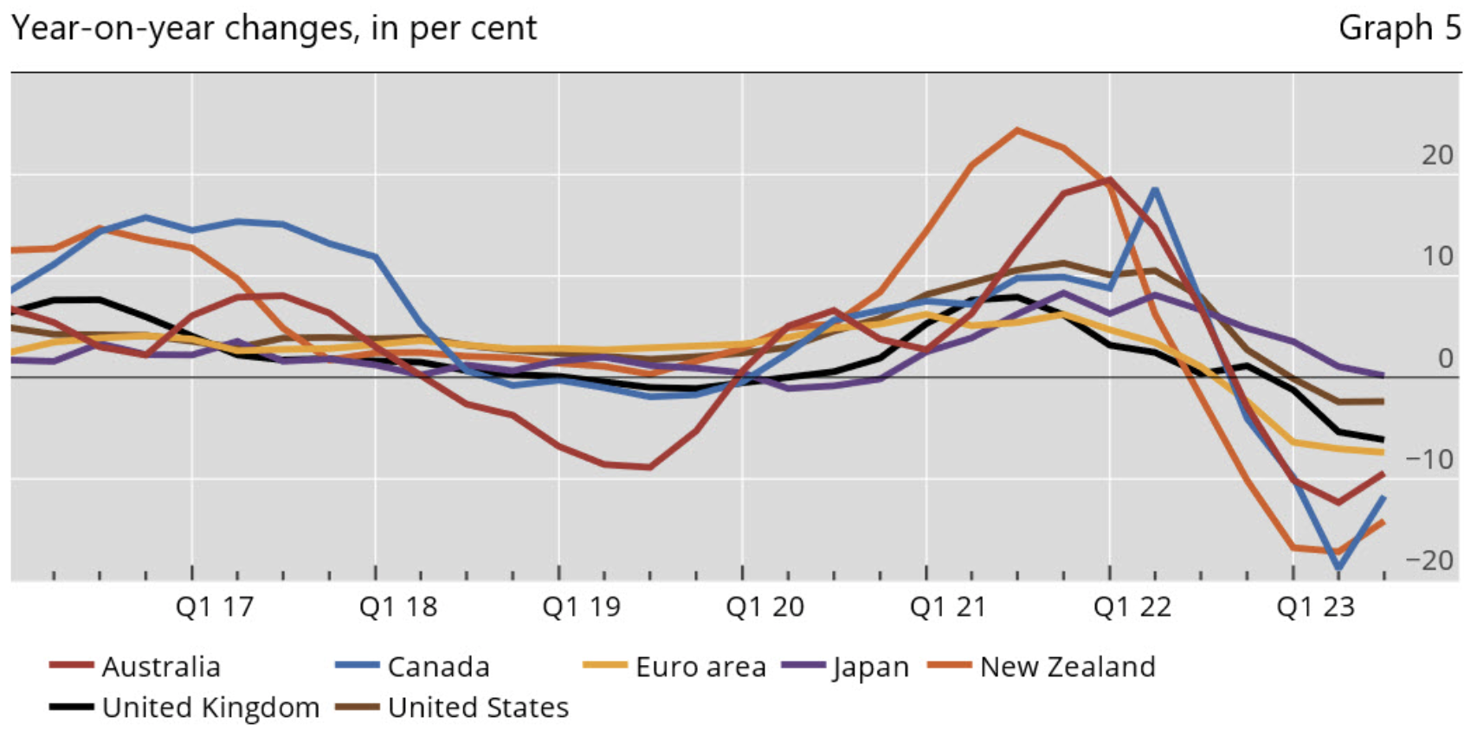
Home prices in the U.S. versus other countries
Increased costs of homeowners’ existing mortgages are a contributor to home prices falling more in other countries compared to the U.S.
https://www.bis.org/statistics/pp_residential_2311.htm

Slide 29
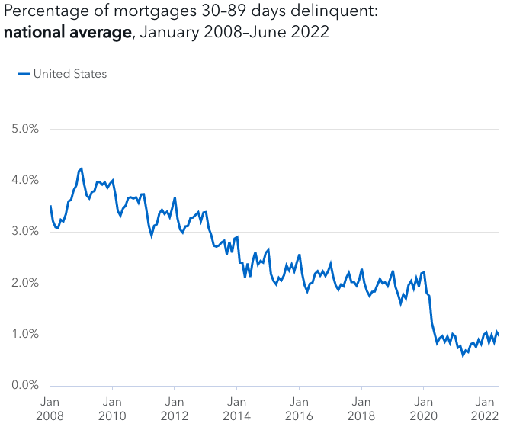
Prepayment Drivers: 3) Defaults
If a borrower defaults on a mortgage in an agency-backed pool, the GSE will buy the loan out of the pool and put cash into the pool. For an investor, the impact is a prepayment on that mortgage. These are referred to as “involuntary prepayments”.
GSE’s will only buy mortgages that satisfy FICO, LTV, DTI, etc. requirements, so defaults have a small impact on Agency-backed prepayment speeds (compared to voluntary prepayment or turnover).
For example, the “serious delinquency rate” for single-family homes in April 2022 was 0.94%
Mortgages default rates in Non-Agency-backed MBS may be higher than for mortgages in Agency-backed
Sources https://www.fanniemae.com/media/43641/display
https://www.consumerfinance.gov/data-research/mortgage-performance-trends/mortgages-30-89-days-delinquent/

Slide 30
Calculating Prepayment Speeds
Stylized Prepayment Model
where
and where
Where and are constants representing average CPRs based on pool, issuer, structure and initial maturity
Where x, y, z… p, q, r… are variable factors distributed around 1.0 based on historical prepayment data, the level of interest rates and volatilities along each path

Slide 31
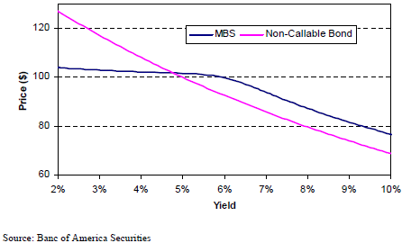
Effect of Prepayment on Valuation / Convexity
Prepayments are correlated with interest rate movements
Rates fall: homeowners refinance their mortgages
Rates rise: refinancing decreases and prepayments slow down
Prepayments cause negative convexity in Pass-Through securities
As rates fall, principal is received earlier (contraction) and reinvested at a lower rate
As rates rise, slower prepayments (extension) lead to less reinvestment when yields are higher
Changes in prepayment rates dramatically affect the duration of mortgage backed securities

Slide 32
Impact of changing prepayment speeds
Holding interest rates and volatility constant, how would MBS prices be impacted
If the Market Value of a Passthrough was par (price = 100%) and then prepayment speeds increase and the yield curve is
1) flat unchange
2) upward sloping increase
If the Passthrough is a “premium bond” (price > par), and then prepayment speeds increase and the yield curve is
1) flat or decrease think the extreme case all prepaid tomorrow, price go to PAR
2) upward sloping
If the Passthrough is a “discount bond” (price < par), and then prepayment speeds increase and the yield curve is
1) flat or
2) upward sloping
Breakout Rooms

Slide 33
Conceptual OAS* Model
Generate interest rate paths through time
Along each path, generate the “Current Coupon”**
Use prepayment model to generate prepayments along each path
Generate cash flows
Discount the cash flows using a spread over LIBOR rates (L-OAS) or over Treasuries (T-OAS) such that the average of the PV across all the interest rate paths equals the Market Price observable for the MBS
* Option Adjusted Spread (OAS)
** Current Coupon is the net coupon of the TBA settling in the nearest month that is trading at par

Slide 34
Generating Interest Rate Paths
Term Structure Model consistent with Market Prices
Treasuries, Swaps
Volatility surface – swaptions, caps, floors
As noted, not going into these in this class
Sample monte-carlo simulation of 1-month LIBOR

Slide 35
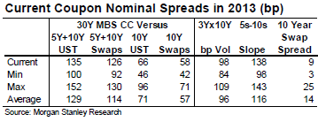
What is OAS?
Conceptually: spread received exceeding {benchmark rate + costs to hedge prepayment risk}
The difference between the zero-volatility spread* and the OAS is an indication of the compensation the market requires for hedging prepayment risk
LIBOR OAS (bps)
* zero-volatility spread; the cash flow spread described in a prior lecture (not YTM)

Slide 36
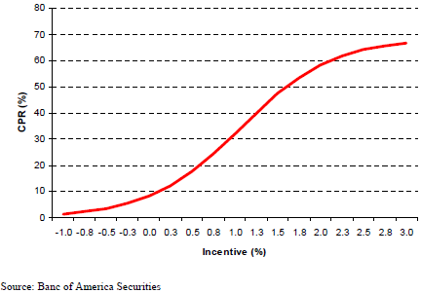
Impact of changing the OAS, Current Coupon
Holding interest rates and volatility constant
If OAS increases
Existing MBS prices will change in what way? Increase or decrease?
What will happen to the Current Coupon? PAR under current coupon. Market discount at higher rate than rf, so coupon rate should be higher to make it at PAR
If Current Coupon increases
What will happen to prepayment speeds of existing MBS?
Slow down, fewer chance to refinance
Smaller Incentive
Larger Incentive

Slide 37
Impact of changing volatility
Holding int rates constant, if implied vol increases, then MBS prices will… ?
Asymmetric, BUT slopes small=> option worth less => MBS price increases
Roughly symmetric, but slope large => MBS price could decrease
If vol increases, larger increase in speeds than decrease => option worth more. BUT, difference in slope small => small MBS price decrease
Magnitude of impact depends upon the coupon of the MBS versus the current coupon
Impact is mitigated by the Current Coupon changing

Slide 38
Build a Toy OAS Model
1) Given: a Pass-Through
2) Given: N interest rate paths through time
3) Given: prepayments along each path
4) Generate cash flows
5) Discount the cash flows using a spread over Fed Fund forwards (or LIBOR rates: L-OAS) such that the average of the PV across all the interest rate paths equals the Market Price observable for the MBS
This step requires solving for the OAS

Slide 39
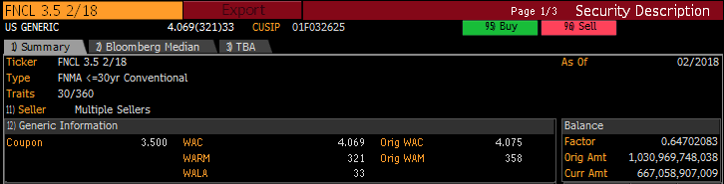
Step 1
Important terms and conditions:
Source: Bloomberg FNCL 3.5 2/18 Mtge DES

Slide 40
Step 2 – Generate Cash Flows
Generate cash flows for five interest rate paths. For simplicity, use
-40bps (shock the forwards down 40 bps)
-20bps (shock the forwards down 20 bps)
Forwards “Spot”
+20bps (etc.)
+40bps (etc.)
Source: Bloomberg FWCV

Slide 41
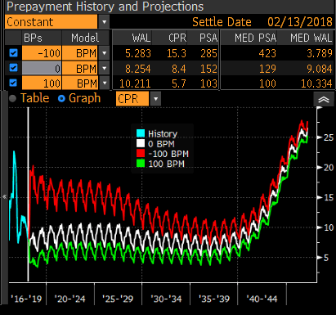
3) Given prepayments along each path
Using the Bloomberg Prepayment Model (BPM)
Source: Bloomberg FNCL 3.5 2/18 Mtge PVG

Slide 42
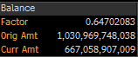
4) Generate Cash Flows
Given the Pass Through
Assume all loans are 4.075%, 358 mth maturity
33 WALA => 33 months since origination and when the Passthrough was issued
Net cpn 3.5% => Servicing/g-fee: 57.5bps
Assume SMMs identical during first 33 months and solve for SMM such that factor is 0.64702083
Given CPRs for each of the five Interest Rate Paths
Convert CPRs to SMMs
Assume all are curtailments (no prepayments!)
Generate Cash Flows for each path

Slide 43
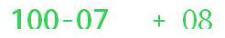
5) Solve for the OAS
After generating three sets of cash flows, discount each set using a spread over the corresponding LIBOR rates to arrive at five prices, such that the average of the five prices equals the market-observable price (e.g. Bid price)
Note: conveniently, the price is always expressed as a % of the current notional, not of the original notional
Discounting requires incorporating a spread over the 1-month forwards:

Slide 44
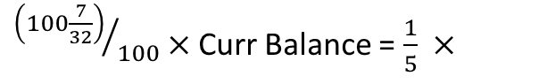
5) Solve for the OAS cont’d
Solve for the Option Adjusted Spread (OAS) such that the average of the PVs for each of the five paths equals the observable market price
${\left(100\frac{7}{32}\right)}/{100}×$Curr Balance = $\frac{1}{5} ×$

Slide 45
Homework Part I
Build a toy OAS model based on
Pass Through described in previous pages
Five paths of 1mth LIBOR forwards (-40bps, -20, 0, +20, +40)
Five paths of CPRs
Calculate the WAL each month through time for each path
Solve for the OAS
Assuming CPRs do not change when rates are shocked, calculate
PV01 (change in PV for +1bp shock to interest rates)
PV-100 (change in PV after shocking forwards down 100bps)
PV+100 (change in PV after shocking forwards down 100bps)
Calculate the credit spread sensitivities
CS PV01 (change in PV for +1bp shock to OAS)
CS PV-100
CS PV+100

Slide 46
Homework Part II
4. Hold OAS constant and calculate chg in PV if rates drop 100bps, rise 100bps given:
Shocked 1mth LIBOR forwards
For -100, use: -60, -80, -100, -120, -140
For +100, use: +60, +80, +100, +120, +140
Paths of CPRs corresponding to the forwards
Plot in one graph #2, #4
X-axis: shock to forwards
Y-axis: chg in Price
Explain why PV changes at -100, +100 are different for #2 vs #4
Describe the relationship of PV changes for #3 to #2 and #4
Readings
Salomon Smith Barney Guide to MBS and ABS
Chapters 1, 4, 5

Slide 47
Homework Part II: shocked interest rates (three sets of five paths)

Slide 48
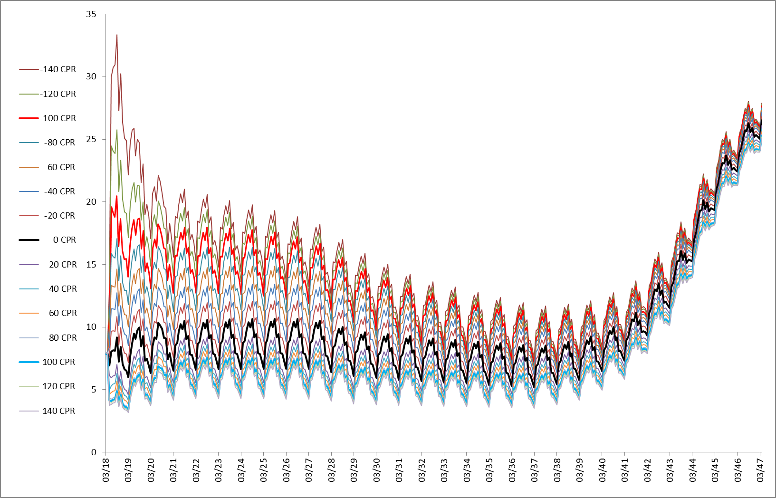
Homework Part II: CPR’s for shocked interest rates (3 x 5 paths)

Slide 49
Appendix
Other

Slide 50
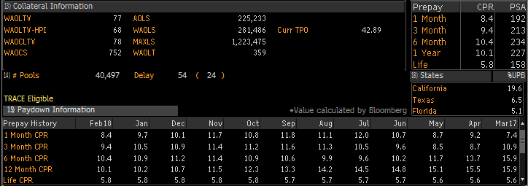
Appendix:
Other terms appearing in FNCL 3.5 2/18 Mtge DES:
Wtd Avg Orig LTV
Wtd Avg Orig LTV – HPI adjusted
Wtd Avg Orig Combined LTV (CLTV includes second liens)
Wtd Avg Orig Credit Score
Avg Orig Loan Size
Wtd Avg Orig Loan Size
Max Loan Size
Wtd Avg Orig Loan Term to Maty
Current Third-Party Origination %
Source: Bloomberg FNCL 3.5 2/18 Mtge DES

Slide 51
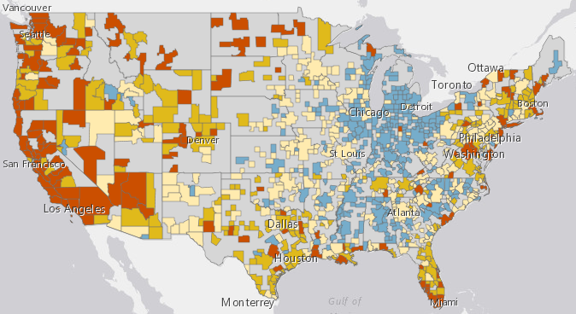
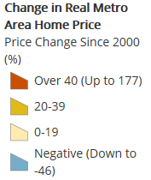
Factors Impacting Turnover
Price Changes from 2000 to 2016
http://harvard-cga.maps.arcgis.com/apps/MapSeries/index.html?appid=0e9603b62db14611834fd3dfd8645316

Slide 52
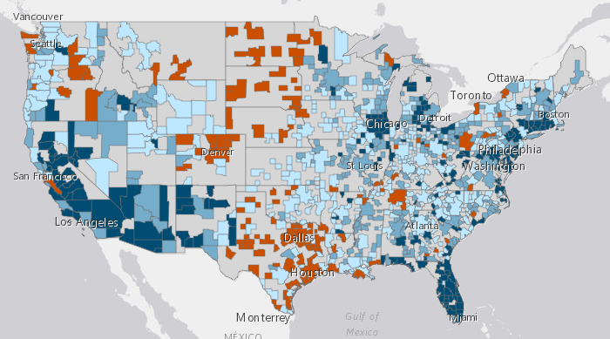
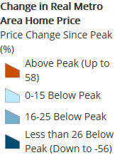
Factors Impacting Turnover
Peak to 2016 price changes
http://harvard-cga.maps.arcgis.com/apps/MapSeries/index.html?appid=0e9603b62db14611834fd3dfd8645316

Slide 53
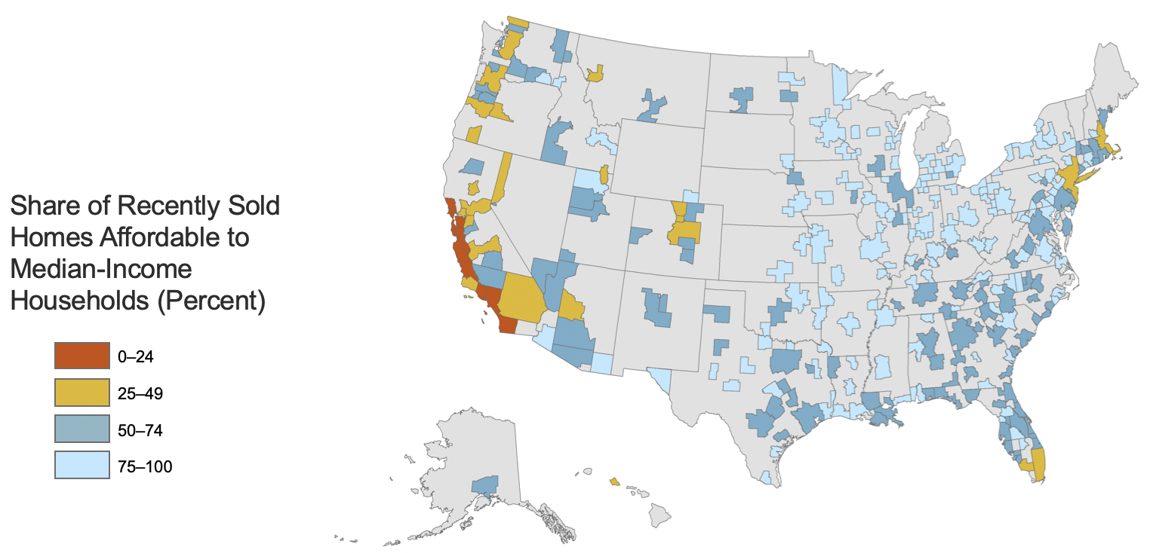
Factors Impacting Turnover
Affordability
Notes: Median incomes are estimated at the core-based statistical area (CBSA) level. Recently sold homes are defined as homes with owners that moved within the 12 months prior to the survey date. Monthly payments assume a 3.5% downpayment and property taxes of 1.15%, property insurance of 0.35%, and mortgage insurance of 0.85%. Affordable payments are defined as requiring less than 31% of monthly household income. Only CBSAs with at least 30 home sales in the past year are shown.
Source: JCHS tabulations of US Census Bureau, 2017 American Community Survey 1-Year Estimates, and Freddie Mac, PMMS.
http://harvard-cga.maps.arcgis.com/apps/MapSeries/index.html?appid=0e9603b62db14611834fd3dfd8645316

Slide 54
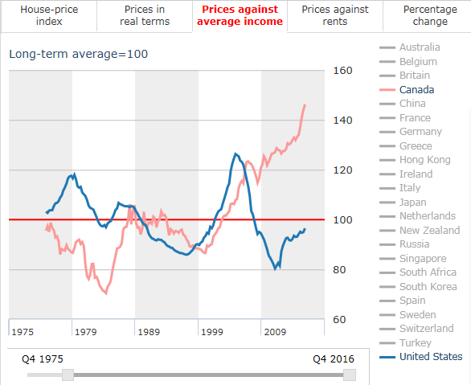
Factors Impacting Turnover
Affordability
What do you think the trend was in China from ~1996 to 2016?
Up or Down?
https://www.economist.com/blogs/graphicdetail/2017/03/daily-chart-6

Slide 55
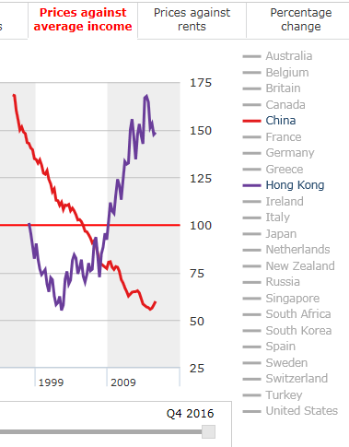
Factors Impacting Turnover
Affordability
https://www.economist.com/blogs/graphicdetail/2017/03/daily-chart-6

Slide 56
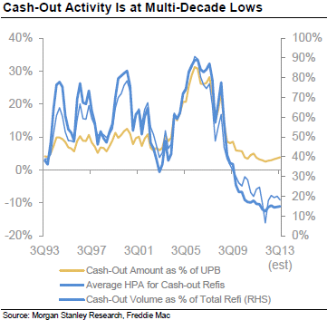
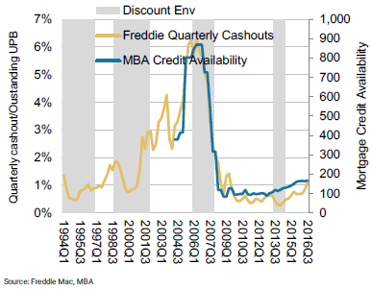
Factors affecting a borrower’s ability to refinance
3) Changes in underwriting standards

